Slide 1
Enterprise Application Development
Lab 4 - Designing a Login and
Registration System using Redis

Slide 2
Steps to use the system & System Specifications

Slide 3
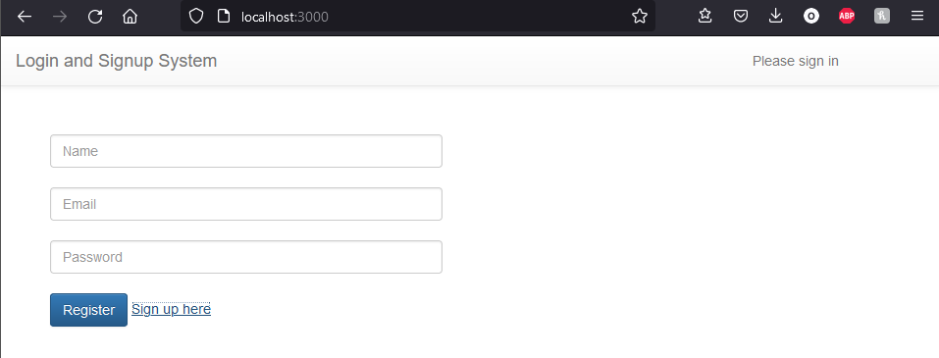
Register Page
Users must first create an account to use the system.
For this, they will need three things.
Name
Email
Password

Slide 4
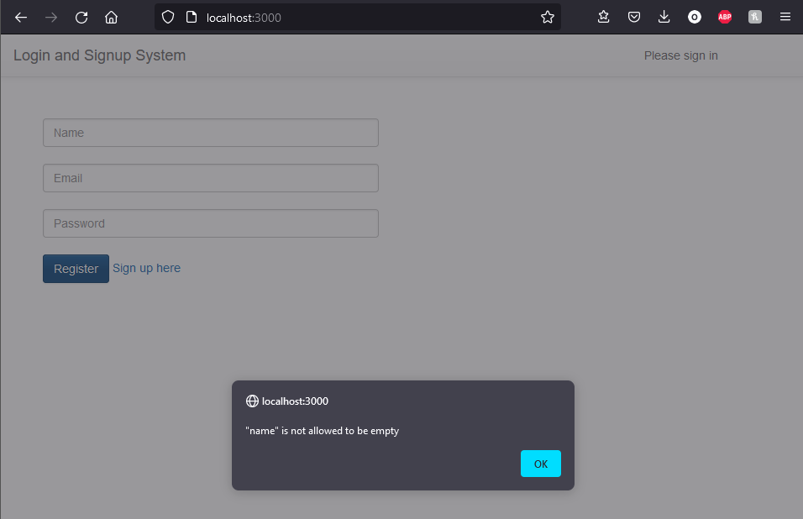
Register Page – Bad/Incorrect Input
When creating a user all the fields must be valid.
Any incorrectly filed field will result in a pop-up describing the error.

Slide 5
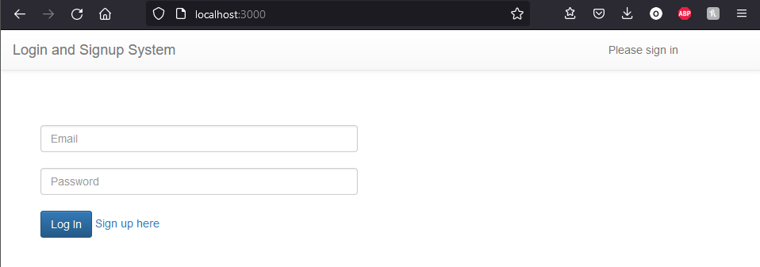
Login Page
When logging in, the user must use their registered email and password.
If the user does not have an account they can press the “Sign up here” button

Slide 6
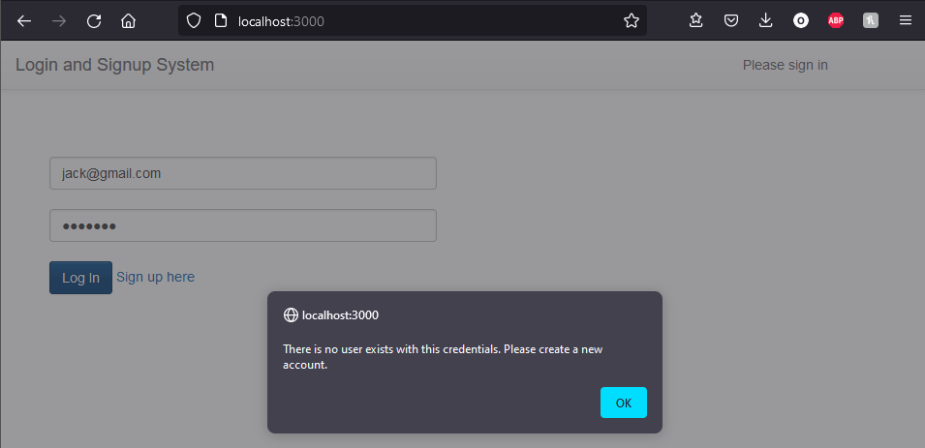
Login Page - Fail
If the User’s email is not recognized they will receive a pop-up saying:
“There is no user exists with this credentials. Please create a new account.”
If the user’s password is incorrect they will receive a pop-up saying:
“Invalid email or password”

Slide 7
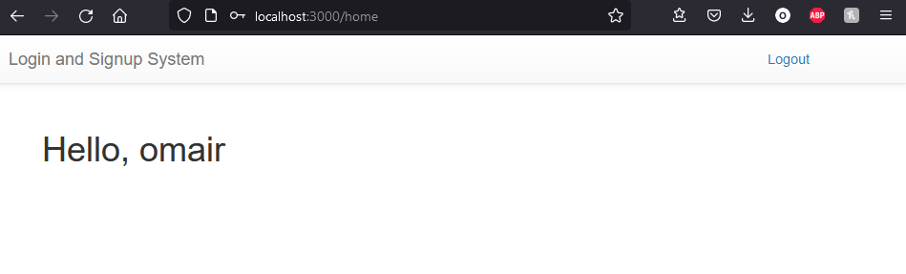
Home Page
After logging in the user will be greeted with a sign which says Hello and their name.

Slide 8
Redis Session & Logging Out
If the user opens a new window with the localhost, they will continue to be logged in.
The user can log out from the top right button.
This will only log them out in the current window however

Slide 9
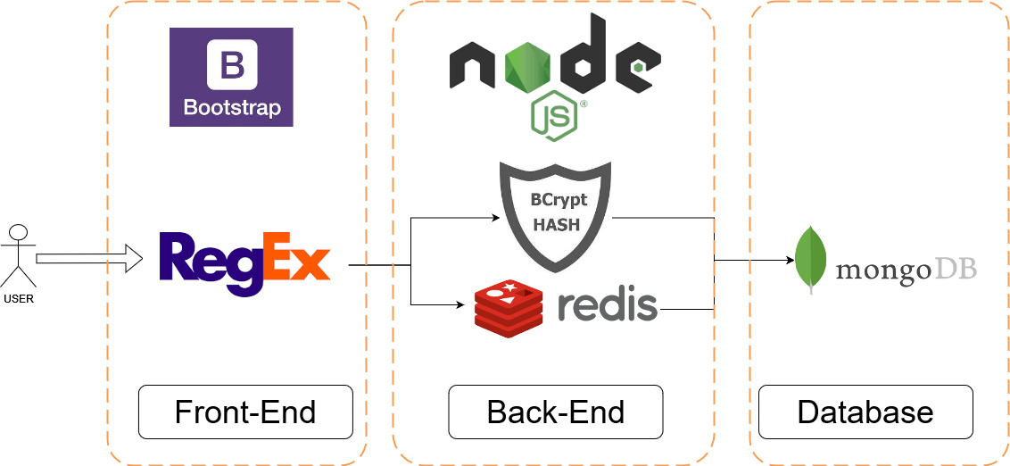
Structure of Application

Slide 10
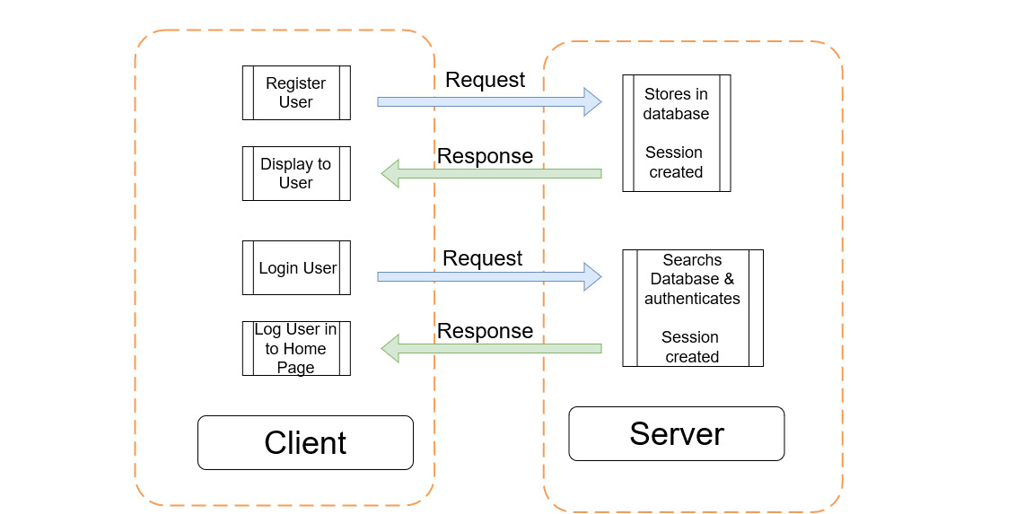
Client-Server Interaction

